Slide 1

Tech Gadget Usage and Mental Wellbeing
Aaron Tan
Mini-Project 2
#2025-07-08-ds-pt-wa-sg

Slide 2

The Double-Edged Screen: A Modern Paradox
Essential Integration
70% of Americans check their phones within 15 minutes of waking up. Our devices have become extensions of ourselves, managing everything from communication to commerce.
Hidden Consequences
Increased screen time correlates with 20% higher rates of anxiety and depression symptoms, revealing technology's darker psychological impact.

Slide 3


Connection vs. Disconnection
Digital Connection
Emotional Isolation
Technology bridges distances, enabling meaningful relationships and instant communication across the globe.
Paradoxically, excessive digital interaction can lead to feelings of loneliness and social disconnection in real life.

Slide 4




The Dopamine Trap: How Tech Hijacks Our Brains
Notification Trigger
Dopamine Release
Craving Cycle
Each ping, buzz, or flash activates our brain's reward system, creating anticipation for potential rewards.
Likes, comments, and messages trigger dopamine bursts, the same neurotransmitter involved in addiction pathways.
Users spend 2.5 hours daily on social media, trapped in cycles of seeking validation and stimulation.

Slide 5
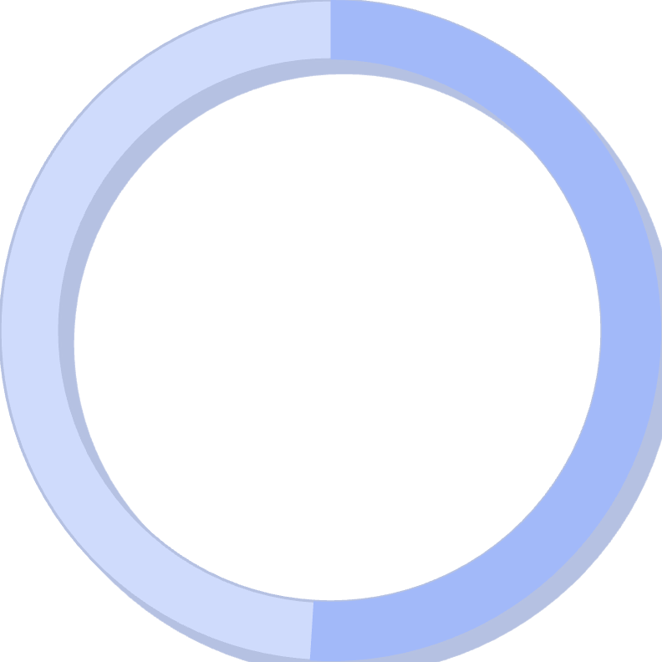
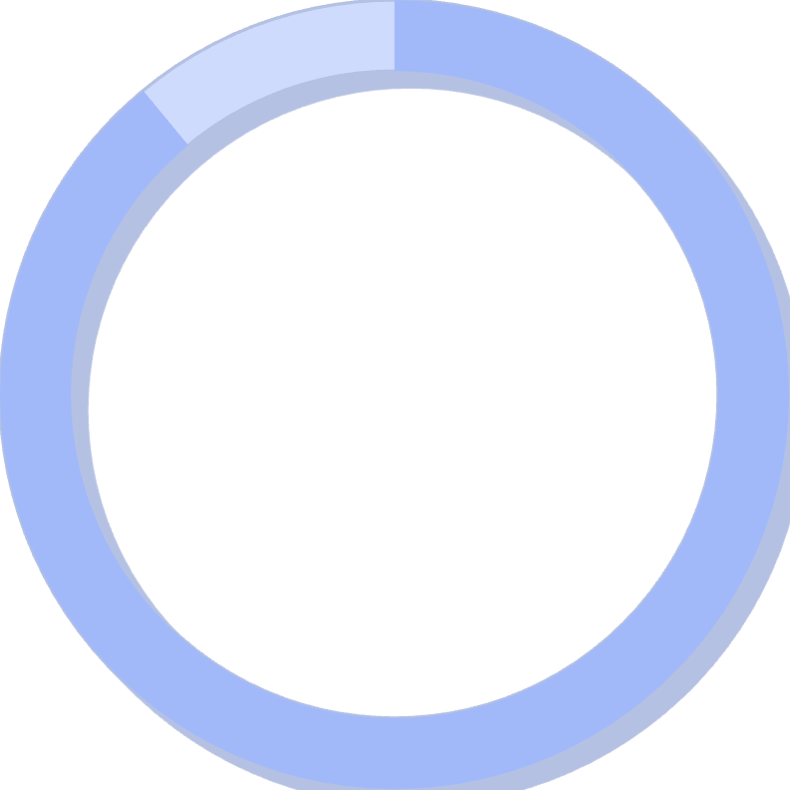
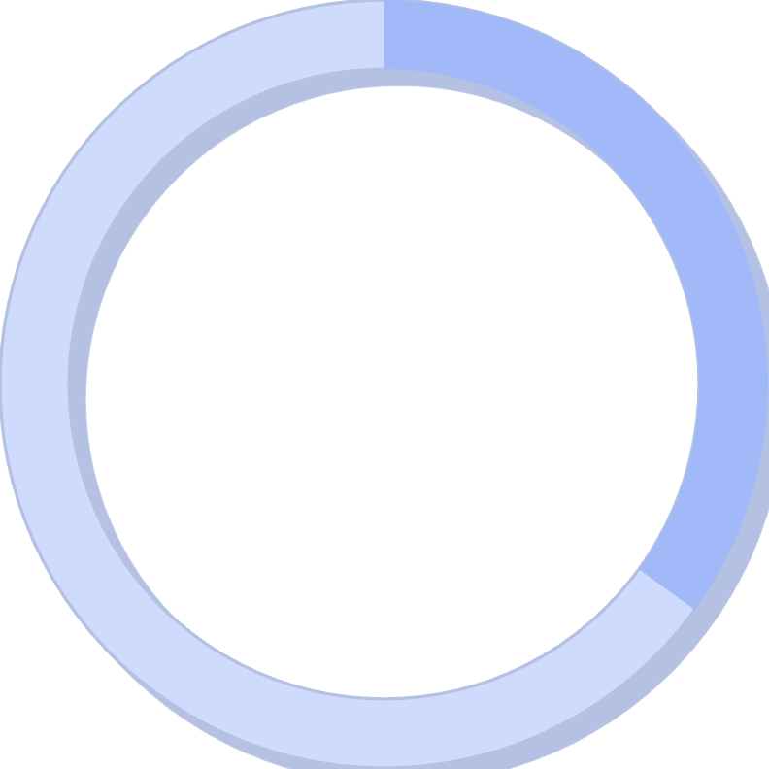
The Comparison Game: Social Media's Impact on Self-Esteem
51%
89%
35%
Teen Inadequacy
Filtered Reality
Body Image Issues
Report feeling inadequate due to social media comparisons with peers and influencers.
Of social media posts use filters or editing, creating unrealistic beauty standards.
Increase in body dysmorphia cases linked to social media usage among young adults.
"The curated perfection of online profiles fuels unrealistic expectations, creating a dangerous gap between digital fantasy and authentic reality."

Slide 6
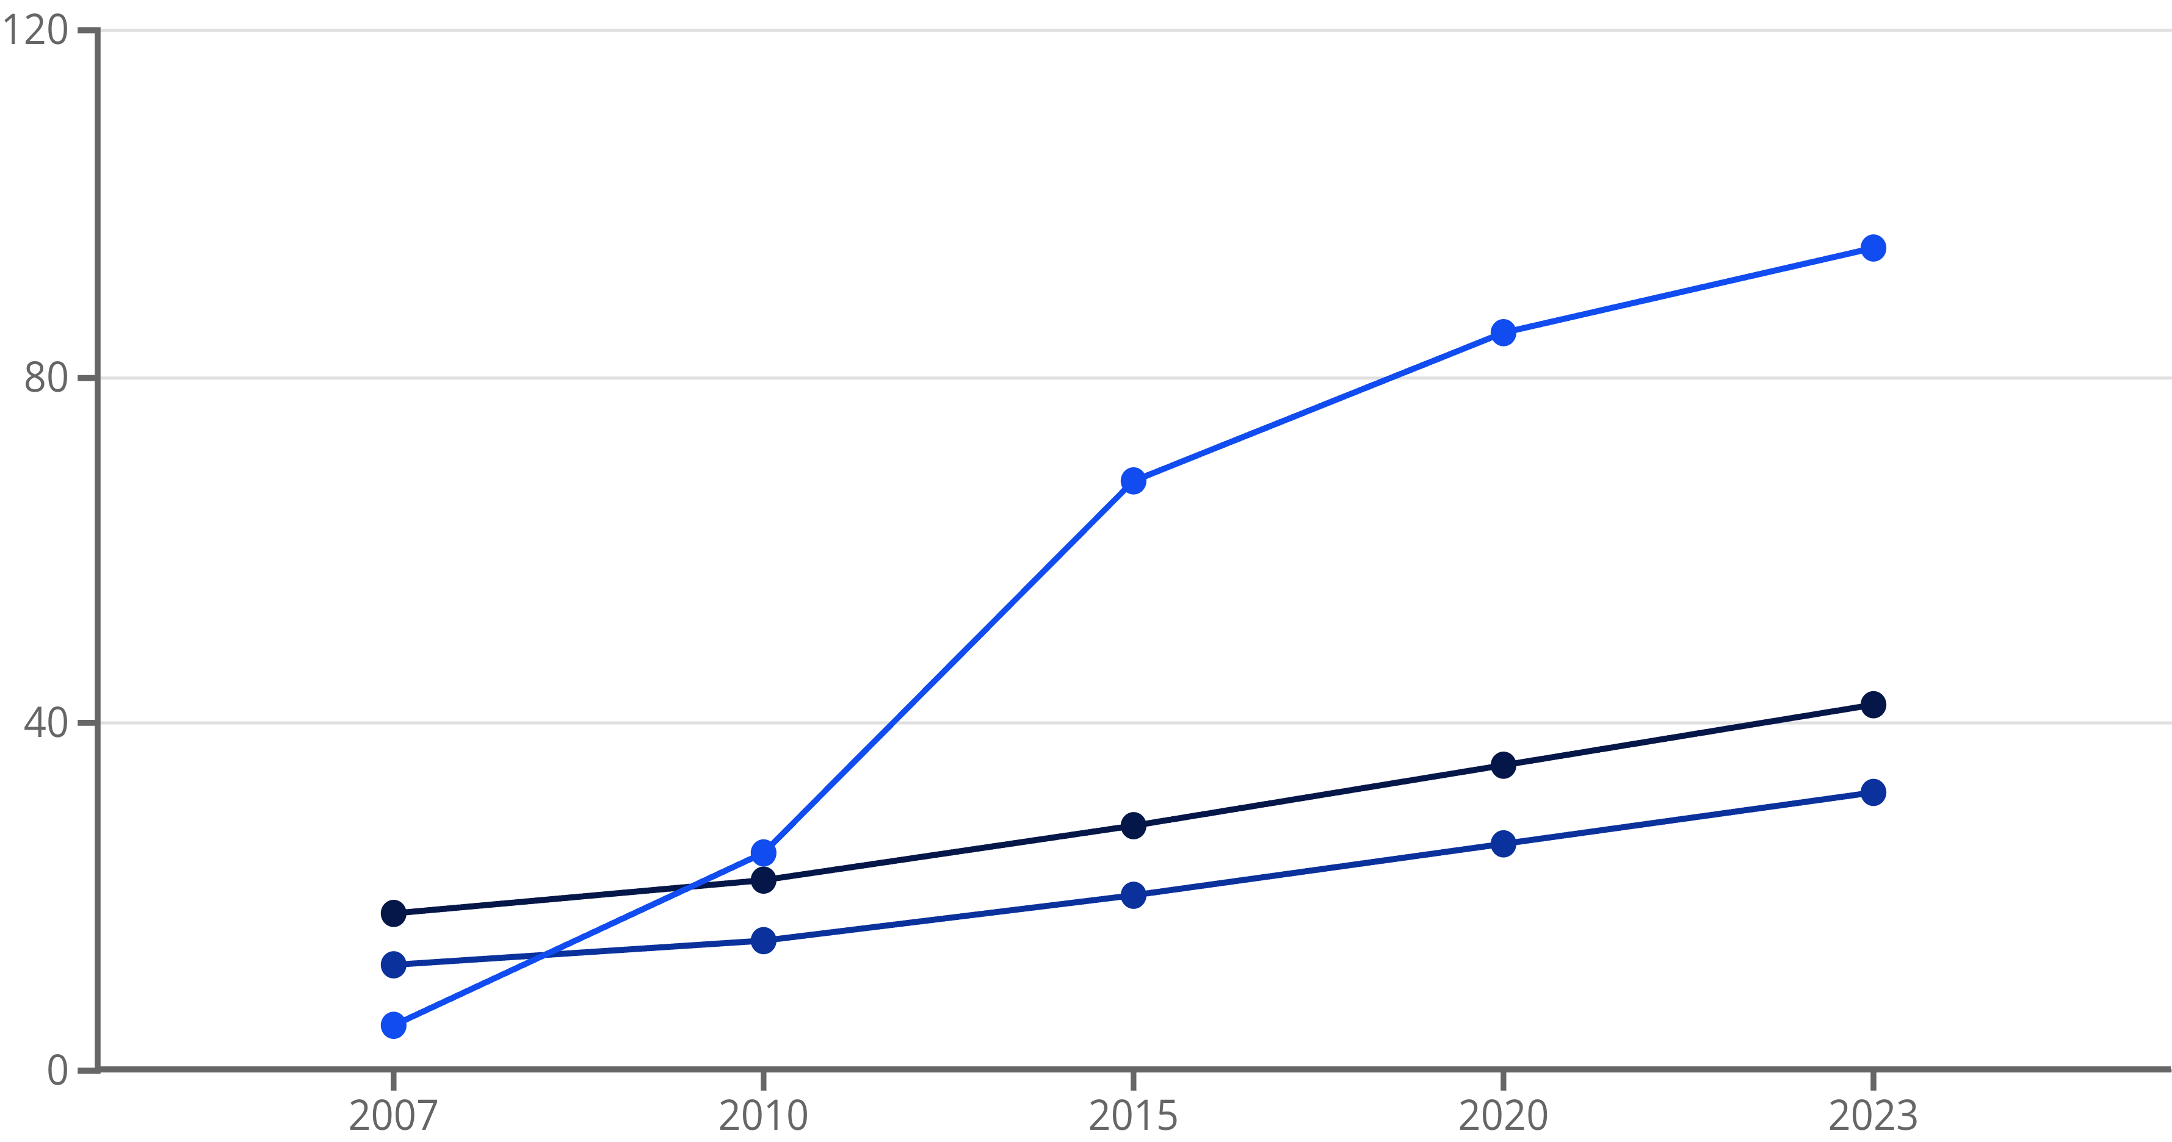
The Mental Health Crisis Timeline
Anxiety Rates (%)
Depression Rates (%)
Smartphone Adoption (%)
The correlation between rising smartphone adoption and increasing mental health challenges among young people raises critical questions about causation versus correlation in our digital age.

Slide 7

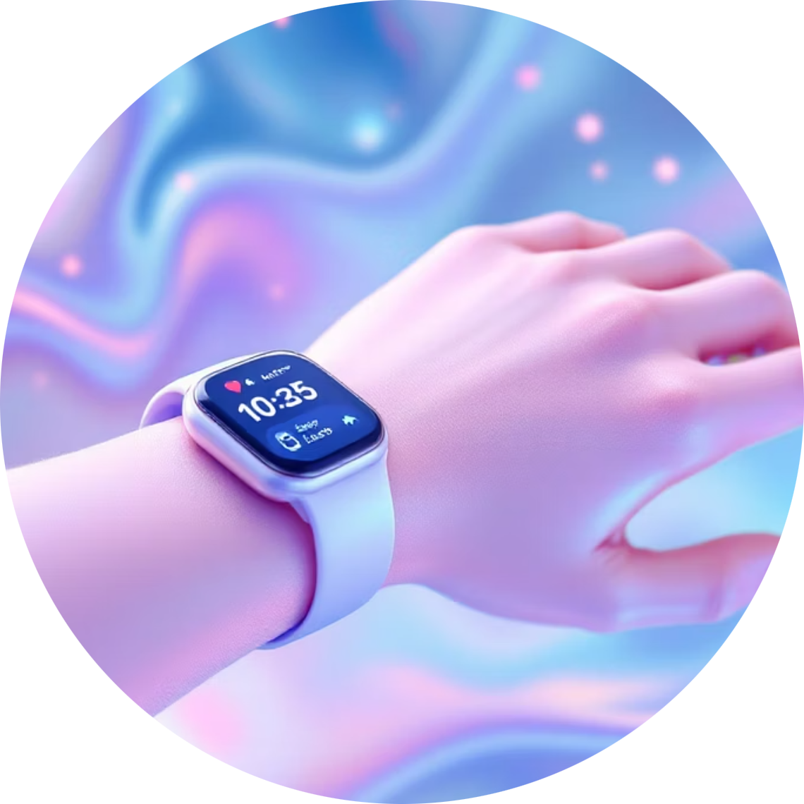


Tech as a Tool for Wellbeing: The Silver Linings
Mindfulness Apps
Wearable Wellness
Digital Therapy
Platforms like Headspace and Calm provide guided meditations, sleep stories, and breathing exercises accessible anytime, anywhere.
Smart devices track sleep patterns, heart rate variability, and stress levels, offering personalized insights for better health management.
Teletherapy platforms break down barriers to mental health care, providing professional support to those who might otherwise go without.
When used intentionally, technology becomes a powerful ally in our mental health journey, offering tools and resources that were unimaginable just decades ago.

Slide 8
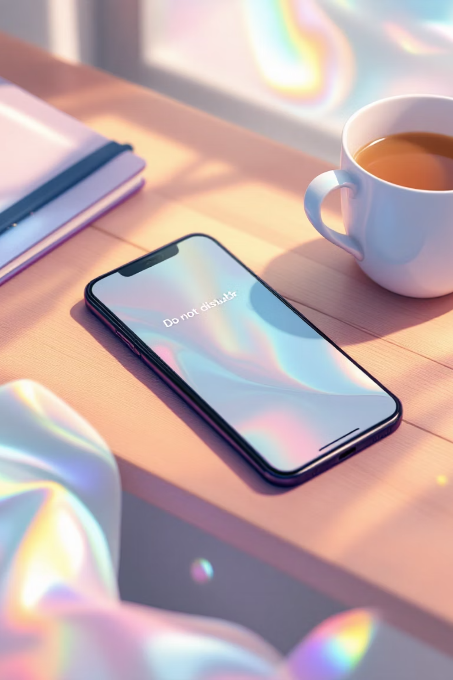
Digital Detox: Reclaiming Your Time and Mind
01
Set Sacred Boundaries
Create tech-free zones and times: no devices during meals, one hour before bed, or first thing in the morning.
02
Curate Your Digital Environment
Unfollow accounts that trigger negative emotions. Follow creators who inspire, educate, and uplift your mental state.
03
Practice Mindful Engagement
Before picking up your device, pause and ask: "What am I hoping to accomplish?" Avoid mindless scrolling.
04
Embrace Analog Alternatives
Rediscover physical books, handwritten journals, face-to-face conversations, and outdoor activities without digital distractions.

Slide 9

Finding Balance
The Art of Intentional Living
"The goal is to live life in such a way that our technologies amplify our humanity rather than diminish it."
True digital wellness isn't about completely abandoning technology—it's about developing a conscious, intentional relationship with our devices.
When we choose presence over productivity, connection over consumption, we transform technology from master to servant.

Slide 10




The Future is Now: Tech's Role in Mental Wellness
Technology is Neutral
Embrace Supportive Tools
Our devices aren't inherently good or bad—their impact depends entirely on how mindfully and intentionally we choose to use them.
Actively seek out and utilize technologies that genuinely support your mental health, productivity, and overall wellbeing.
Take Control
You are the architect of your digital life. Set boundaries, make conscious choices, and prioritize your psychological wellness above all else.
As we navigate this digital age, remember that the power to shape technology's impact on our mental health lies firmly in our hands. Choose wisely, live intentionally, and let technology serve your highest good.

